Slide 1


Data Structure
Course Code: ETCCDS202
School of Engineering and Technology
K. R. Mangalam University
Program: B.Tech/ B.SC
Dr. Shahjad

Slide 2

Session 2
Abstract Data Types (ADTs)
Notes:
New Courses replaced with New Programmes

Slide 3
Recall: Structures – The Foundation
Data = raw facts (72, “Rahul”)
Information = processed, meaningful data (Rahul scored 72 marks)
Poor organization causes confusion, slow execution, and errors
Key Idea: Computers need well-organized data, not just data.
Notes:
New Courses replaced with New Programmes

Slide 4
Recall: Structures – The Foundation..
Data Structure?
A systematic way to organize, store, and manage data for:
Fast access
Easy updates
Efficient processing
Notes:
New Courses replaced with New Programmes

Slide 5
Recall: Structures – The Foundation
Why Data Structures?
Enable efficient programs & algorithms
Power real-world systems (GPS, browsers, databases)
Essential for problem-solving & interviews
Better structure → Better algorithms → Better software
Types of Data Structures
Primitive: int, char, float, Boolean (Fixed size, fast, limited abstraction)
Non-Primitive: Linear: Array, Stack, Queue, Linked List
Non-Linear: Tree, Graph
Notes:
New Courses replaced with New Programmes

Slide 6
Learning Objectives
After this unit, you will be able to:
Define Abstract Data Types (ADTs) clearly
Distinguish between ADT and Data Structure
Identify operations vs implementation
Map ADTs to real-life systems
Relate ADTs to Arrays, Stack, Queue, and List
Notes:
New Courses replaced with New Programmes

Slide 7
Motivation Starter (Engaging Hook)
Question to students:
When you use an ATM, do you care how money is stored inside the machine?
Expected Answer: No
You only care about:
Withdraw
Deposit
Check balance
This is the idea of abstraction.
Notes:
New Courses replaced with New Programmes

Slide 8
What is an Abstract Data Type (ADT)?
Simple Definition
An ADT defines what operations can be performed on data, without specifying how they are implemented.
An ADT is a conceptual model that defines a set of operations and behaviors for a data structure, without specifying how these operations are implemented or how data is organized in memory.
The definition of ADT only mentions what operations are to be performed but not how these operations will be implemented.
📌
Notes:
New Courses replaced with New Programmes

Slide 9
What is an Abstract Data Type (ADT)?
Focus:
What operations are allowed
Not how they are implemented
Notes:
New Courses replaced with New Programmes

Slide 10
ADT vs Data Structure (Core Concept)
ADT | Data Structure
Logical / Conceptual | Physical / Implementation
What operations? | How operations are done
Independent of language | Language dependent
Notes:
New Courses replaced with New Programmes

Slide 11
Features of ADT Abstract data types
(ADTs) are a way of encapsulating data and operations on that data into a single unit.
Abstraction: Better Conceptualization:
Robust:
Encapsulation:
Data Abstraction:
Data Structure Independence:
Information Hiding:
Modularity:
Notes:
New Courses replaced with New Programmes

Slide 12
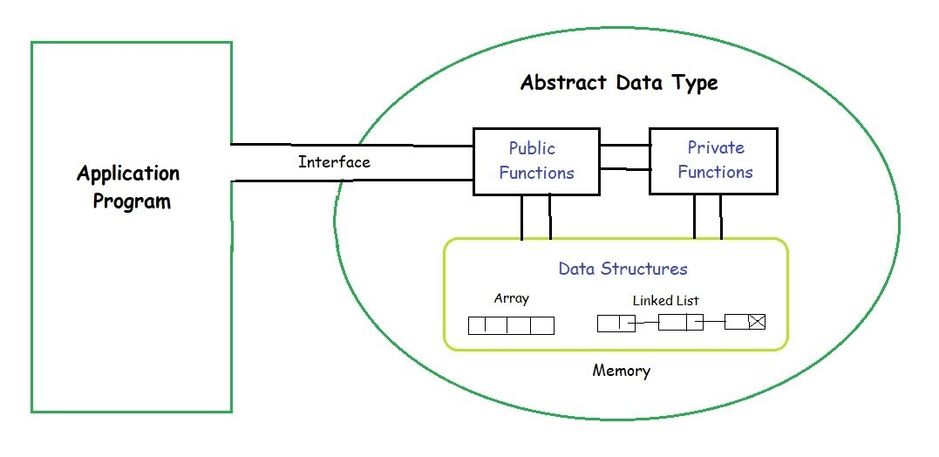
Features of ADT Abstract data types..
Overall, ADTs provide a powerful tool for organizing and manipulating data in a structured and efficient manner.
Notes:
New Courses replaced with New Programmes

Slide 13
CONT..
This image demonstrates how an Abstract Data Type (ADT) hides internal data structures (like arrays, linked lists)
using public and private functions,
exposing only a defined interface to the application program.
Notes:
New Courses replaced with New Programmes

Slide 14
Why Use ADTs?
The key reasons to use ADTs in Java are listed below:
Encapsulation: Hides complex implementation details behind a clean interface.
Reusability: Allows different internal implementations (e.g., array or linked list) without changing external usage.
Modularity: Simplifies maintenance and updates by separating logic.
Security: Protects data by preventing direct access, minimizing bugs and unintended changes.
Notes:
New Courses replaced with New Programmes

Slide 15
Components of an ADT
Every ADT has:
Data (values)
Operations (functions)
Rules/Constraints (behavior)
Notes:
New Courses replaced with New Programmes

Slide 16
Examples of ADTs
Now, let's understand three common ADT’s:
List ADT,
Stack ADT,
and Queue ADT.
1. List ADT
The List ADT is a sequential collection of elements that supports a set of operations without specifying the internal implementation.
It provides an ordered way to store, access, and modify data.
Notes:
New Courses replaced with New Programmes

Slide 17
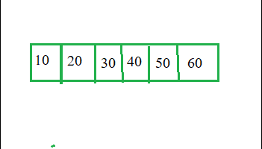
Examples (1): List ADT
Operations:
The List ADT need to store the required data in the sequence and should have the following operations:
get(): Return an element from the list at any given position.
insert(): Insert an element at any position in the list.
Notes:
New Courses replaced with New Programmes

Slide 18
Examples (1): List ADT
remove(): Remove the first occurrence of any element from a non-empty list.
removeAt(): Remove the element at a specified location from a non-empty list.
replace(): Replace an element at any position with another element.
size(): Return the number of elements in the list.
isEmpty(): Return true if the list is empty; otherwise, return false.
isFull(): Return true if the list is full, otherwise, return false. Only applicable in fixed-size implementations (e.g., array-based lists).
Notes:
New Courses replaced with New Programmes

Slide 19
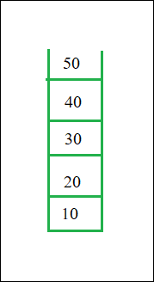
Example (2): Stack ADT
The Stack ADT is a linear data structure that follows the LIFO (Last In, First Out) principle. It allows elements to be added and removed only from one end, called the top of the stack.
Notes:
New Courses replaced with New Programmes

Slide 20
Example (2): Stack ADT
Operations:
In Stack ADT, the order of insertion and deletion should be according to the FILO or LIFO Principle. Elements are inserted and removed from the same end, called the top of the stack.
push(): Insert an element at one end of the stack called the top.
pop(): Remove and return the element at the top of the stack, if it is not empty.
peek(): Return the element at the top of the stack without removing it, if the stack is not empty.
size(): Return the number of elements in the stack.
isEmpty(): Return true if the stack is empty; otherwise, return false.
isFull(): Return true if the stack is full; otherwise, return false. Only relevant for fixed-capacity stacks (e.g., array-based).
Notes:
New Courses replaced with New Programmes

Slide 21
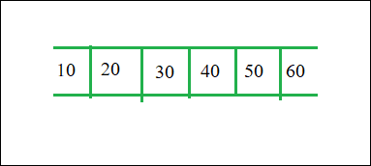
Example (3): Queue ADT
The Queue ADT is a linear data structure that follows the FIFO (First In, First Out) principle.
It allows elements to be inserted at one end (rear) and removed from the other end (front).
Notes:
New Courses replaced with New Programmes

Slide 22
Example (3): Queue ADT..
Operations:
The Queue ADT follows a design similar to the Stack ADT, but the order of insertion and deletion changes to FIFO. Elements are inserted at one end (called the rear) and removed from the other end (called the front). It should support the following operations:
enqueue():
dequeue():
peek():
size():
isEmpty():
Notes:
New Courses replaced with New Programmes

Slide 23
Common ADTs with Real-Life Mapping
ADT | Operations | Real-Life Analogy
Stack | push, pop | Undo / Stack of plates
Queue | enqueue, dequeue | Ticket line
List | insert, delete, traverse | To-do list
Deque | insert/remove both ends | Train compartments
Priority Queue | insert, delete-max/min | Hospital emergency
Notes:
New Courses replaced with New Programmes

Slide 24
ADT vs Programming Example (Conceptual)
Queue ADT says:
Enqueue
Dequeue
Implementation choices:
Array-based Queue
Linked List Queue
➡️ Same ADT, different data structures.
Notes:
New Courses replaced with New Programmes

Slide 25
Advantages and Disadvantages of ADT
Abstract data types (ADTs) have several advantages and disadvantages that should be considered when deciding to use them in software development.
Advantage:
The advantages are listed below:
Encapsulation:
Abstraction:
Data Structure Independence:
Information Hiding:
Modularity:
Notes:
New Courses replaced with New Programmes

Slide 26
Advantages and Disadvantages of ADT..
Disadvantages:
The disadvantages are listed below:
Overhead:
Complexity:
Learning Curve:
Limited Flexibility:
Cost:
Notes:
New Courses replaced with New Programmes

Slide 27
Guided Classroom Activity (High Engagement)
Activity: Design Your Own ADT
Problem: Design an ADT for:
Music Playlist OR
Online Shopping Cart
Students must specify:
Data items
Operations
Rules
(No coding allowed ❌)
Notes:
New Courses replaced with New Programmes

Slide 28
Reflection Question (Think Deep)
Why is separating what a structure does from how it is implemented important in large software systems?
Notes:
New Courses replaced with New Programmes

Slide 29
Thank You
Notes:
New Courses replaced with New Programmes

